Slide 1
FACE RECOGNITION
Submitted By:
Piyush Kakkar
B.Tech(IT)
Enr. No: 02996403114
I 789

Slide 2
What is Face Recognition?
A face recognition system is a computer application capable of identifying or verifying a person from a digital image or a video frame from a video source.
One of the ways to do this is by comparing selected facial features from the image and a face database.
It is a complex process and challenging because it needs to detect faces which are not rigid and have a high degree of variability in size, shape, color and texture.

Slide 3
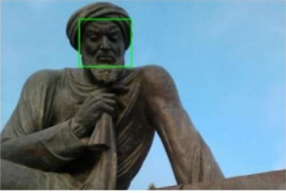
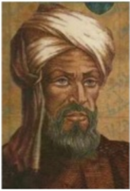
Difference in Face Detection and Face Recognition
Face Detection
Face Recognition
Where is the face?
Who is this person?

Slide 4
Applications of Face Recognition
Criminal Identification
Biometric security system
Image and film processing
Gaming
Tagging
Image search
Human computer interaction

Slide 5
Viola Jones Approach
Object Detection using Haar feature-based cascade classifiers is an effective object detection method proposed by Paul Viola and Michael Jones in their paper, "Rapid Object Detection using a Boosted Cascade of Simple Features" in 2001.
The technique was both robust and very quick (15% faster than any techniques available at that time).
It gives 95% accuracy at around 17fps
It is a machine learning based approach where a cascade function is trained from a lot of positive and negative images.

Slide 6
Viola Jones Approach
AI Section
Recognition Section
Learning based on AdaBoost(Adaptive Boost) Algorithm
Classifier cascade
Integral Image
Haar like features

Slide 7
Haar Features
Haar Features – All human faces share some similar properties. These regularities may be matched using Haar Features.
A few properties common to human faces:
The eye region is darker than the upper-cheeks.
The nose bridge region is brighter than the eyes.
Location and size: eyes, mouth, bridge of nose
Value: oriented gradients of pixel intensities
The four features matched by this algorithm are then sought in the image of a face (shown at left).
Rectangle features:
Value = Σ (pixels in black area) - Σ (pixels in white area)
Three types: two-, three-, four-rectangles, Viola & Jones used two-rectangle features
For example: the difference in brightness between the white &black rectangles over a specific area
Each feature is related to a special location in the sub-window

Slide 8

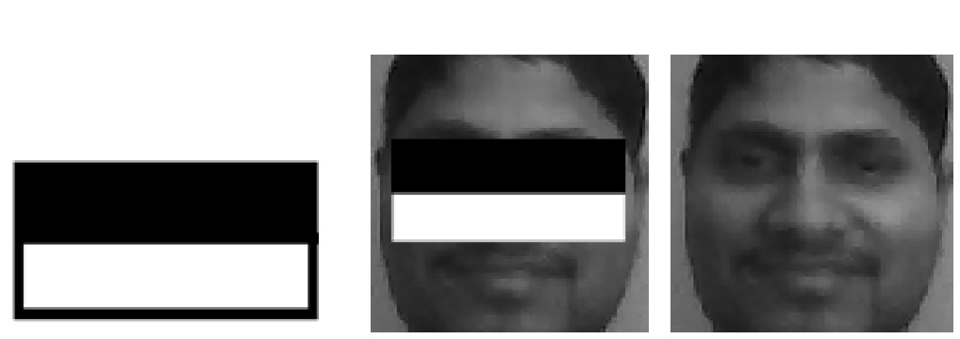

Haar Feature that looks similar to the bridge of the nose is applied onto the face
Haar Feature that looks similar to the eye region which is darker than the upper cheeks is applied onto a face
3rd and 4th kind of Haar Feature

Slide 9
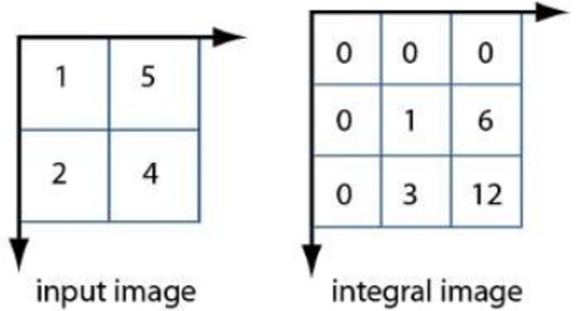
Integral Image
New image representation which allows the features used by our detector to be computed very quickly.

Slide 10
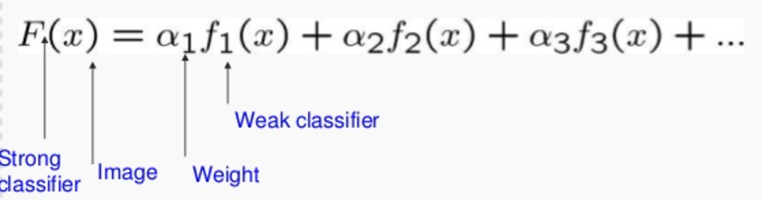
AdaBoost Algorithm
Stands for Adaptive Boost
Constructs a strong classifier as a combination of weighted simple weak classifiers.
Each single rectangle feature may be regarded as a simple weak classifier.
It is an “iterative algorithm” which performs a series of trials, each time selecting a new weak classifier.

Slide 11
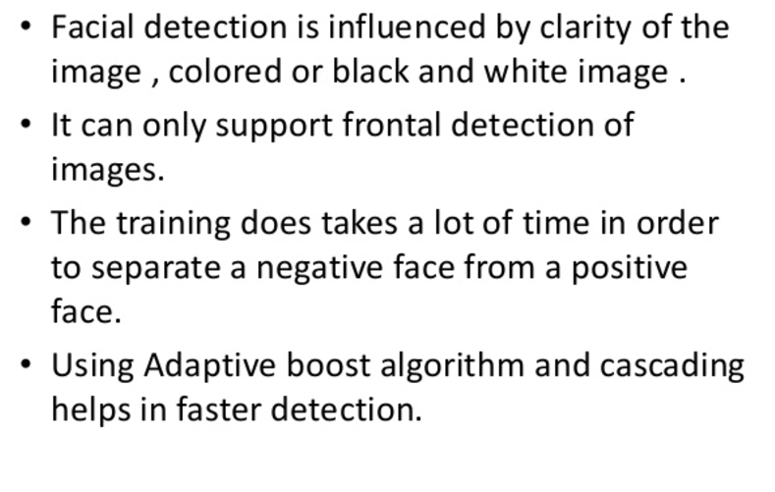
Conclusion

Slide 12
THANK YOU

